Slide 1
IoT Air Quality System
Uli Raich (uli.raich@gmail.com)
Introduction to Micro-Controllers
Presented at the Workshop – IoT4AQ
March 2024, Bambey, Sénégal

Slide 2
Resources
These slides are available for download at
https://github.com/uraich/IoT4AQ_B/tree/main/slides

Slide 3
What is IoT?
Wikipedia:
The Internet of Things (IoT) describes physical objects (or groups of such objects) with sensors, processing ability, software and other technologies that connect and exchange data with other devices and systems over the internet or any other communication networks

Slide 4
IoT
The name “Internet of Things” already suggests that there are two distinct components to it:
Things, which are represented by sensors and actuators. We therefore must have a means to read out these sensors and to control the actuators. Hardware interfaces are needed for this.
Internet, we must be able to send data read from the sensors to the Internet and receive commands for the actuators from it. This means that we need a network interwork and the software to run the network protocols.

Slide 5
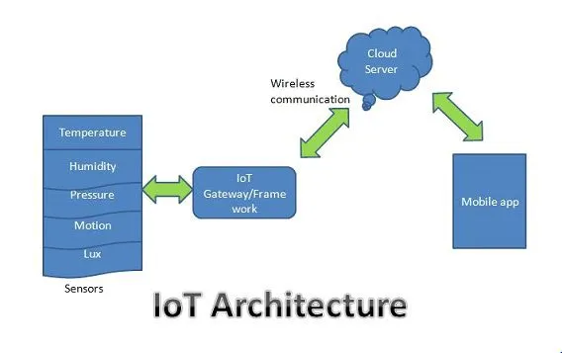
IoT system architecture

Slide 6
What is an IoT system composed of?
We need:
Sensors and actuators
A processor, powerful enough to run the network protocol layers
A network interface: either Ethernet of WiFi
Interfaces to the sensors and actuators:
General Purpose I/O (GPIO) lines
I2C, I2S, SPI, serial interfaces
The cost for the controller should be in a good relation with the cost of the things

Slide 7
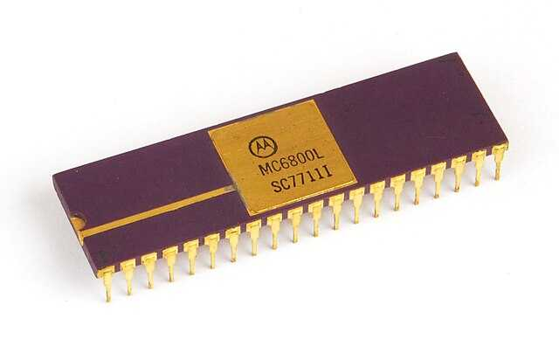
Micro-processors
Up to the 1970’s computers filled racks or even rooms.
Then the micro-processor came onto the market integrating a CPU (Central Processing Unit) onto a single silicon chip.
These devices had no on-chip memory nor on-chip interfaces.
A bus system allowed to connect peripherals.

Slide 8
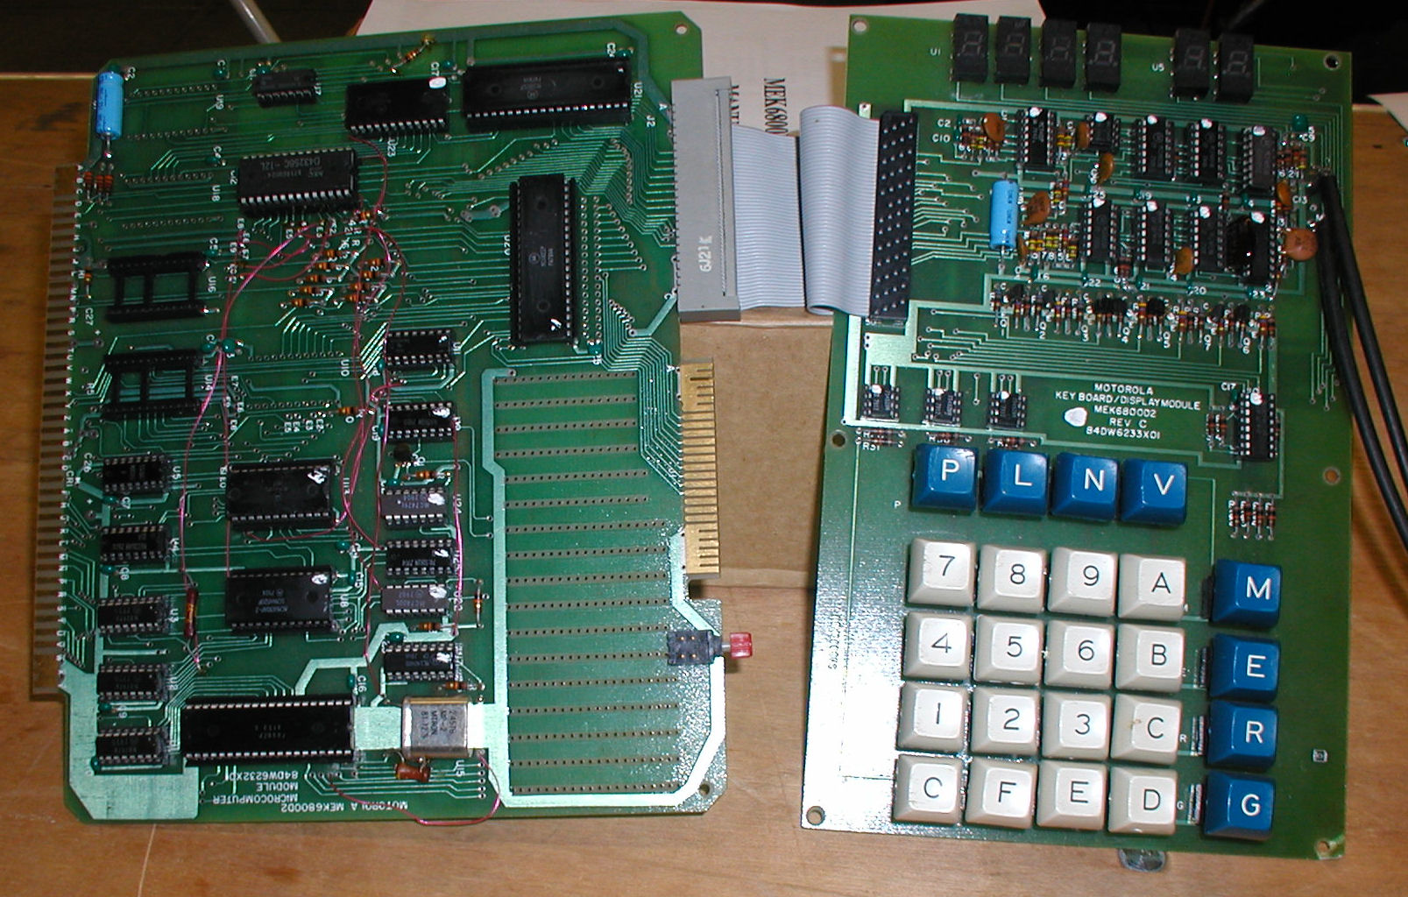
A Micro-processor system
This is how a micro-processor system looked like in the end 1970’s:
1 MHz clock
~ 2 kB of ROM (EPROM) memory
128 bytes of RAM
Keyboard to enter hex instruction code
Audio tape to save programs

Slide 9
Writing programs
These micro-processors were very limited due to their very small memory footprint.
Micro-processors only understand binary coded instructions and every micro-processor type has its own instruction set. In case of the early microprocessors the memory (and the instruction code) was 8-bits wide. We talk of 8-bit micro-processors.
In case of the M6800 development kit, programs were written in assembly language.
This is a (somewhat) human readable programming language with a one to one correspondence with the binary instruction code. In the first course I gave, we wrote the programs on a piece of paper and translated it into machine code by hand. The machine code was then entered using the keyboard.
There were programs (cross-assemblers) which ran on a big computer and which could do his task automatically.
The first samples of the M6800 micro-processor costed several hundred US$

Slide 10
High level languages
Assembly language reflects all the details of the micro-processor hardware because you talk directly to registers and memory, which is difficult, and a program written for processor A does not run on processor B
High level languages like Fortran, C, C++, Java, Python … overcome these problems. Programmers writing code in these languages do not need to know the details of the micro-processor hardware. There is a compiler translating the high level code to assembly language for the machine in question and an assembler, which converts the assembly code into machine instructions.
If the compiler runs on the target machine we speak of a native compiler, if it runs on a different machine and is later uploaded to the target, we speak of a cross-compiler.
Today, almost all programs are written in a high level language. The most popular ones for micro-controllers are C or C++. For more powerful processors Python is a popular choice.

Slide 11
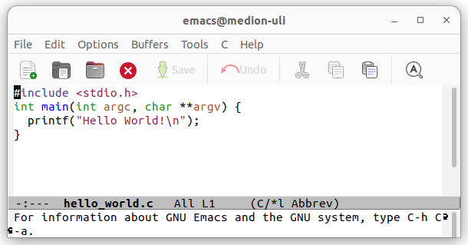
hello_world.c
Let us follow what happens when we compile the ubiquitous hello_world.c program:
Normally we compile, assemble and link, in an automatically executed sequence and do not look at the intermediate steps

Slide 12
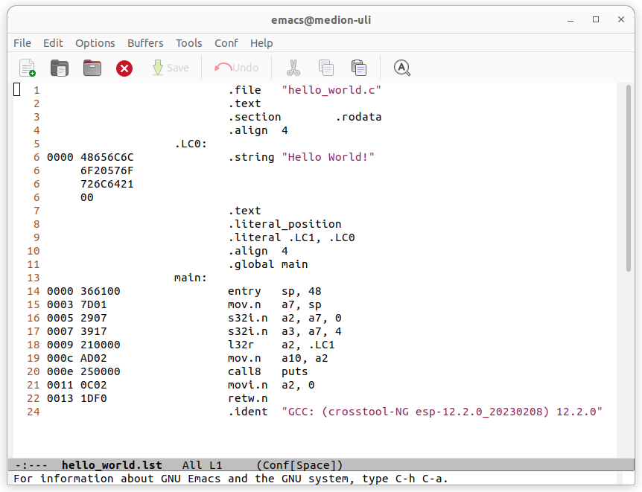
Translate to assembly
First the program is translated to assembly code
This has a one to one correspondence with machine instructions
The assembly code is translated into binary machine code
The machine code is linked to libraries to produce the final executable

Slide 13
Today’s micro-controllers
There are modern micro-controllers which still use 8 bit memory busses like the AVR168 used on the Arduino Uno.
There are two types of memory devices:
RAM: Random access memory
ROM: Read Only memory
In the old times we used EPROMS (Erasable Programmable Read only Memories), which were programmed with a high programming voltage and erased with ultra-violet light.
Today flash memories are used, which are electrically programmable.
Programs can be run off both types of devices but variables must be stored in RAM.

Slide 14
The AVR168
The Atmel AVR168, used in the Arduino Uno (see later) is a
AVR RISC (Reduced Instruction Set Computer) based CMOS 8-bit micro-controller with
16 KB flash memory
512B EEPROM (Electrically Erasable PROM)
1KB SRAM (Static RAM)
20 MHz typical clock speed
It has a series of interfaces: GPIO (General Purpose Input Output) lines, UART (Universal Asynchronous Receiver Transmitter) for serial communication, Two.Wire serial interface, SPI (Serial Peripheral Interface) serial port, ADC (Analog to Digital Converter)
These additional interfaces make it a micro-controller in contrast to a micro-processor, which has the CPU only.

Slide 15
Micro-controller speed
The speed at which a micro-controller can executed your programs depends of its clock speed, its instruction set, memory access speed and the width of its memory bus.
As an example:
The ESP32 uses a dual core (2 CPUs on the chip) Xtensa 32-bit LX micro-processor running at 240 MHz
You can imagine that it will run faster than the AVR168, which has only 8 bits and runs at 20 MHz clock speed.
The Raspberry Pi, as a top end processor, has a Broadcom BCM2711, Quad Core Cortex-A72 (ARM v8) 64-bit processor, running at 1.8 GHz.
You can imagine that the price of the processor depends on its performance.

Slide 16
Software development
Most micro-controller manufacturers provide a Software Development Kit (SDK) for their chips.
These contain
A cross compiler and linker
A build system which automates the compile and link process. Typical build systems are make, cmake, ant, bazel ...
A program to upload the binary code to the micro-controller
Some SDKs have a GUI (Graphical User Interface) into which an editor, the compiler and a debugger are integrated. These are usually called IDEs (Integrated Development Environment)

Slide 17
Compiler versus Interpreter
While compilers translate the source code into a binary program, which is uploaded to the target hardware, an interpreter translates the code on the fly.
In this case the source code is usually translated into byte code, which is binary code for a virtual machine. The virtual machine, a program that acts like a processor with its own instruction set, converts the byte code into the instruction set of the underlying hardware.
The interpreter must run on the target machine. Since this is a rather big program this method can only be used on targets with more resources.
The programs run slower, but you can execute instructions with writing a full program, which makes debugging substantially easier.

Slide 18
The Arduino SDK
Programming, even with high level languages is not an easy task. Writing a program requires an editor to produce the source code.
You may have to read a book to fully understand how to use an editor.
C++ is described by its inventor B. Soustrup in another 1000 pages book.
To fully understand the build system, another 250 pages
Then the debugger …
Programming used to be a job for professional.
The Arduino SDK made programming a micro-controller accessible to everybody.

Slide 19
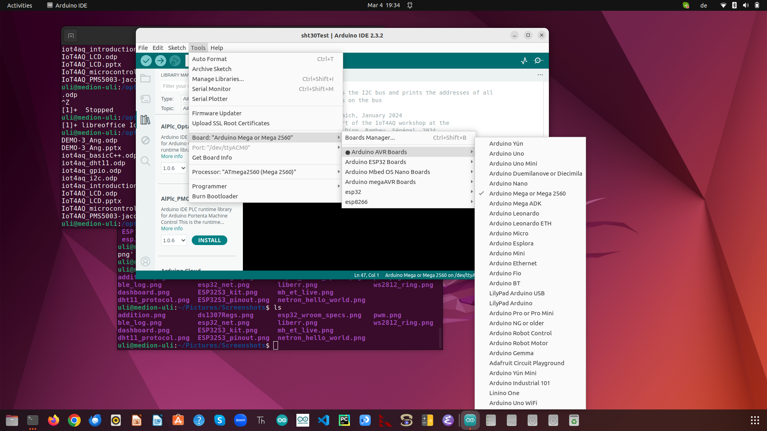
Arduino IDE

Slide 20
The Arduino SDK setup
Before we start programming:
The target machine must be selected
The micro-controller must be connected to the development machine on which the SDK is running, through a serial line. Most target machines use an USB to serial converter
The serial port for uploads must be chosen
The baud rate for upload of binary programs the the micro-controller must be selected
Then we can start editing our program

Slide 21
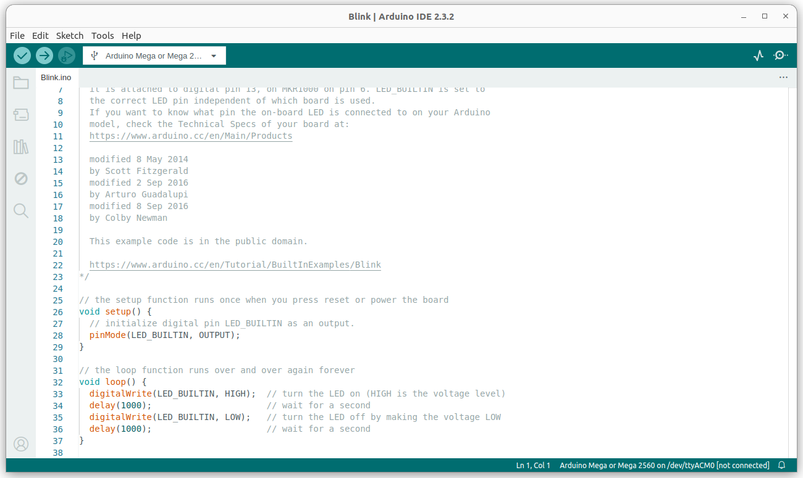
The Arduino editor

Slide 22
Writing Arduino programs
The Arduino programming language is a C++ like language. Most C++ constructs are available
Due to the limited resources of the micro-controller some of the libraries are restricted. Printing is a typical example
An Arduino program consist of 2 parts:
A setup function which is executed once. This function performs all initialization needed, including initialization of sensor and actuator devices
A loop function which is run repetitively.
A micro-controller program almost always has an endless loop

Slide 23
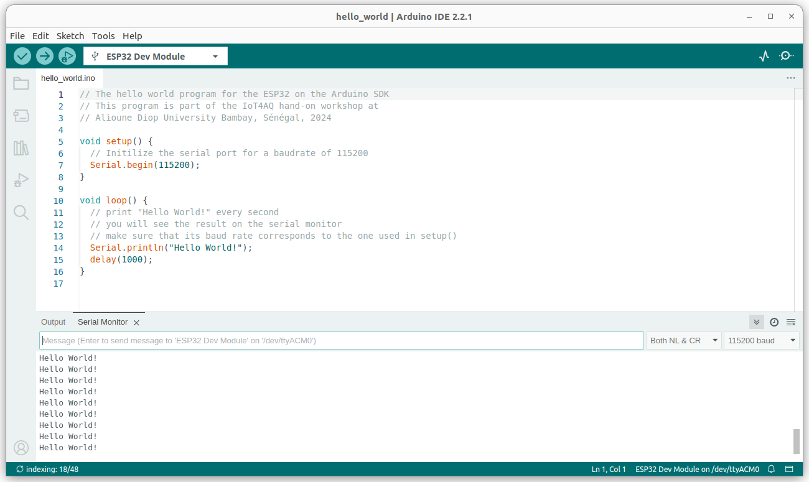
How to get at results
Print the result on the serial line and observe them on the serial monitor

Slide 24
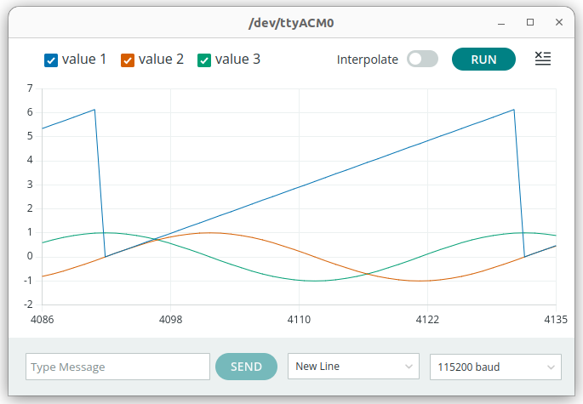
The data plotter
The is also a plotting function in which data, written onto the serial line, will be displayed in a graph.

Slide 25
Checking the system
In C the ubiquitous “hello world” program checks if
You can edit a program
You can compile and link it
You can run it
On embedded systems the simplest program possible is often the “blinking led” program
It shows that you can access the system and that interfacing works

Slide 26
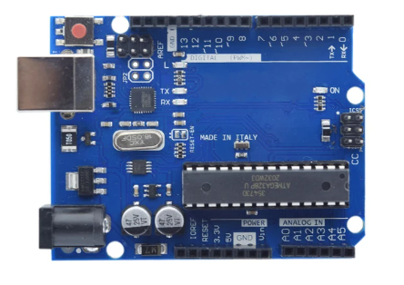
Arduino Uno
The Arduino SDK was developed for the Arduino board (e.g. Arduino Uno) featuring the Atmel
ATMeg328P processor
32kB Flash memory
2kB SRAM
1kB EEPROM
a number of interfaces
GPIO, SPI, I2C, ADC
and a standardized connector for piggy back “shields”

Slide 27
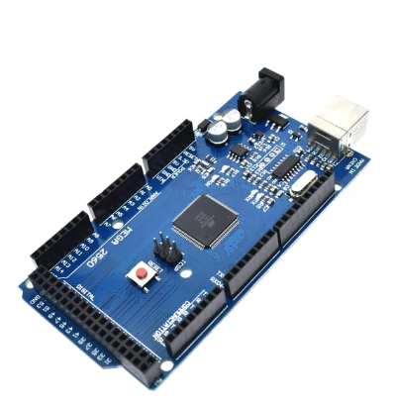
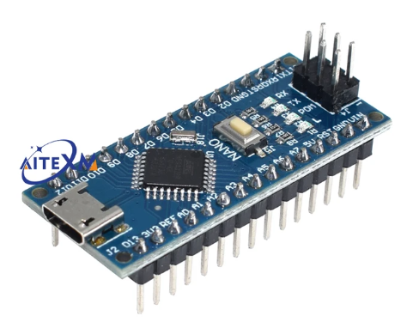
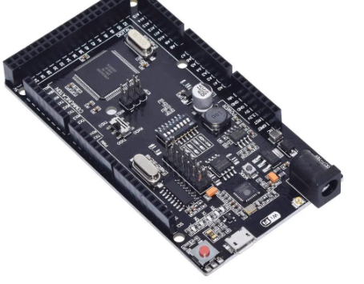
Other AVR Arduinos
Arduino Nano
Smaller footprint
Arduino Mega
Uses Atmega2560 processor
Atmega with WiFi interface

Slide 28
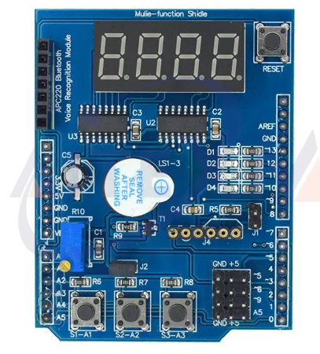
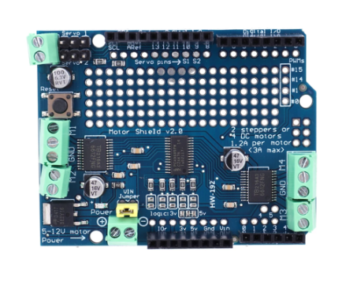
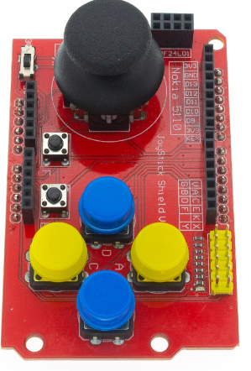
Arduino Shields
Motor controller shield
Joypad shield
Multifunction shield

Slide 29
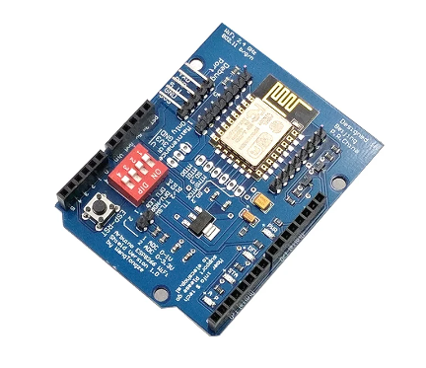
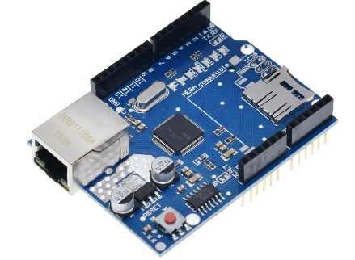
Network shields
Ethernet shield
Wifi shield

Slide 30
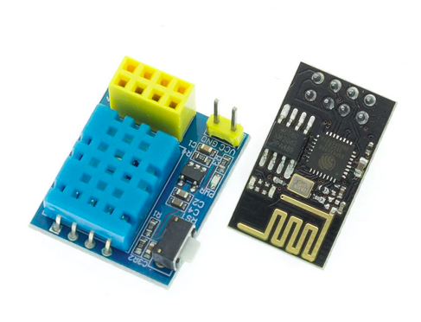
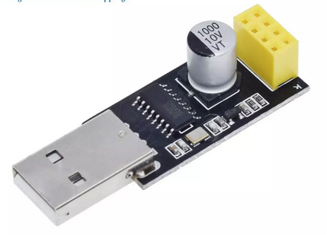
The low end
If you just need an Internet connected temperature sensor, the ESP01 will do!
Cost of processor and sensor: < 2 US $
In addition you need a programmer for a few cents.
Temperature and humidity sensor
programmer
processor

Slide 31
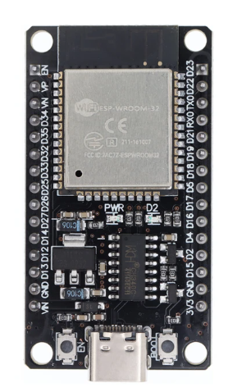
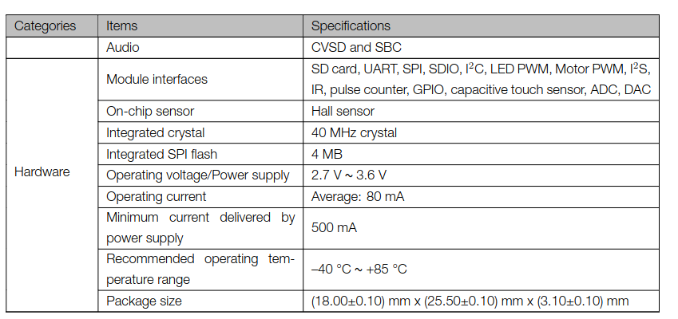
The ESP32 micro-controller

Slide 32
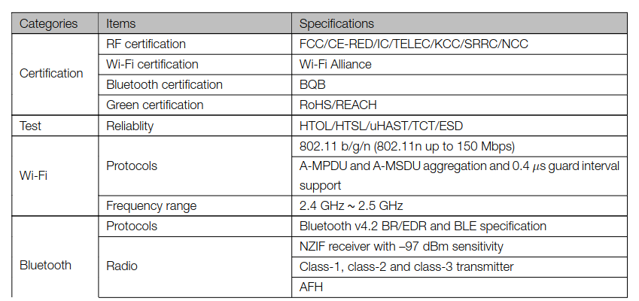
ESP32 network connection

Slide 33
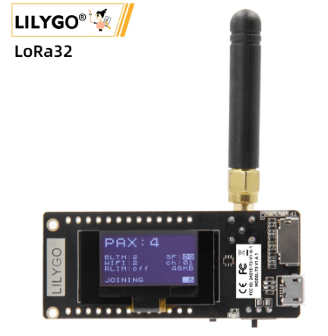
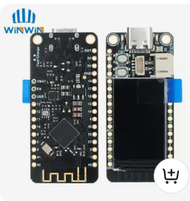
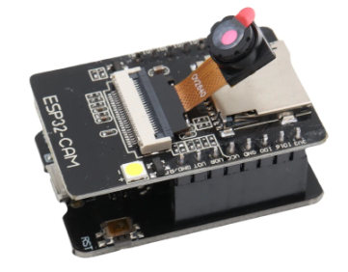
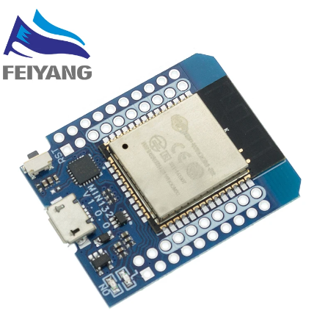
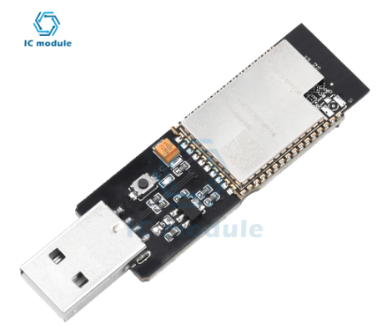
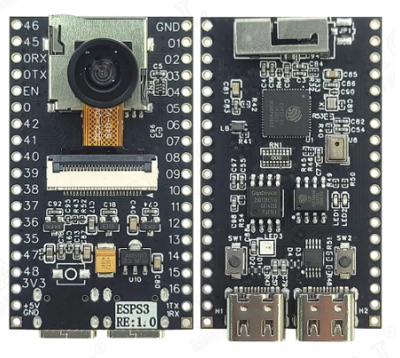
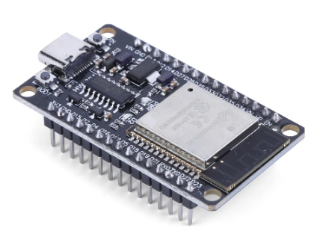
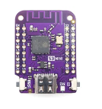
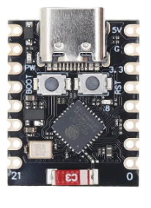
Other ESP processors
ESP32 WeMos
ESP32 LoRa
ESP32 with LCD
ESP32-CAM
ESP32C3
RiscV
ESP32 S3 with camera
and microphone
ESP32S3
WeMos

Slide 34
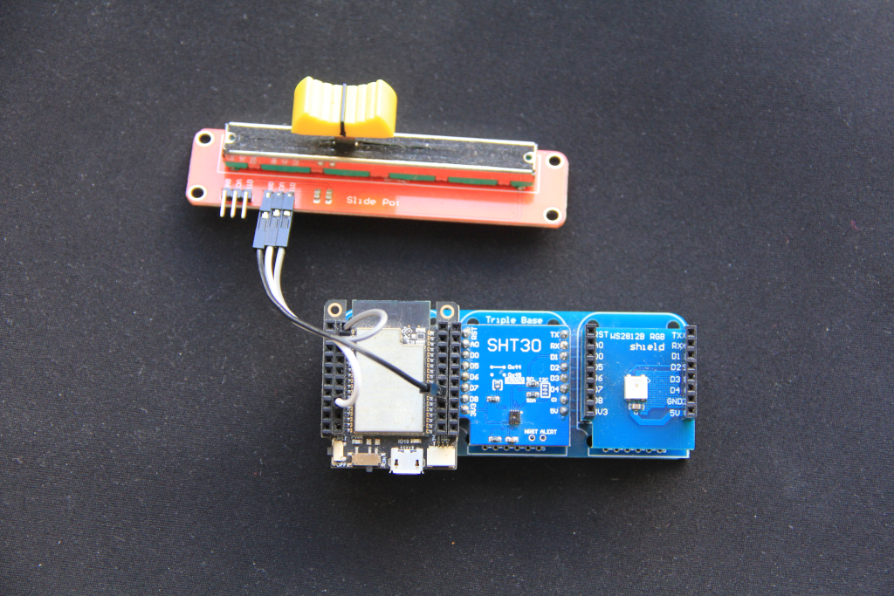
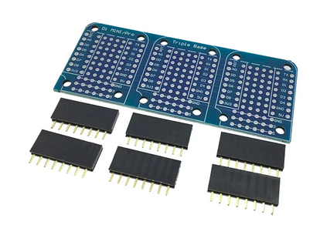
The WeMos D1 mini bus
The WeMos D1 mini system is particularly interesting because is provides a bus system which avoids the bread board with all its cabling.
The CPU is connected to its peripherals through a back plane.

Slide 35
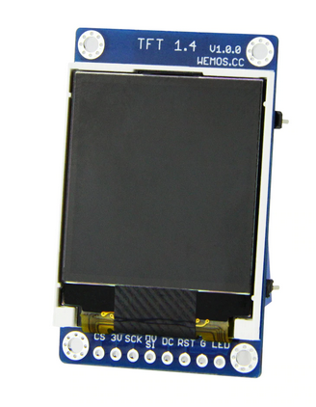
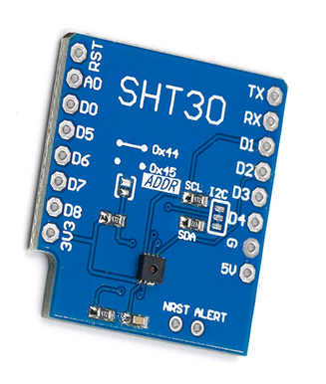
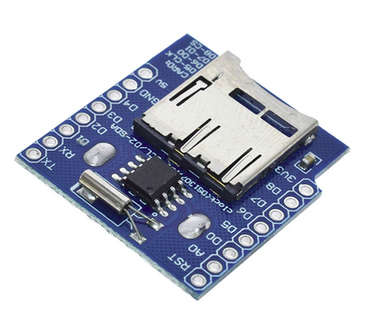
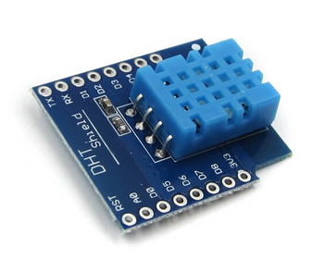
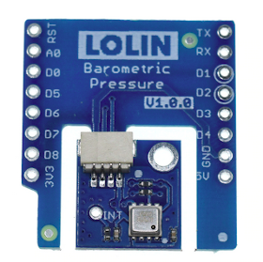
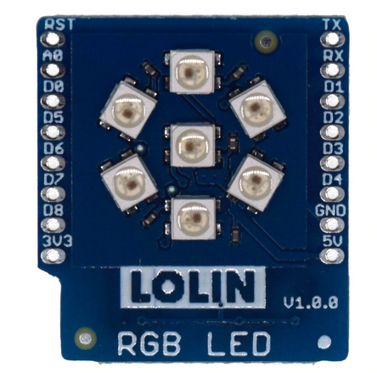
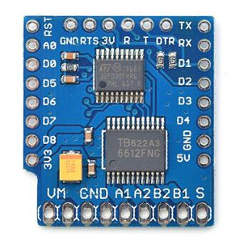
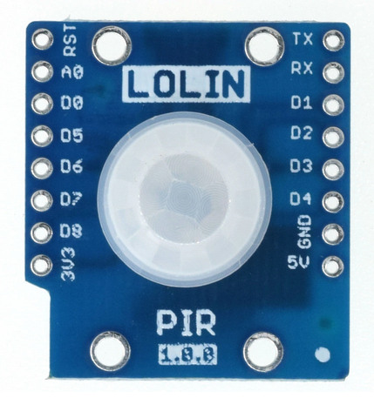
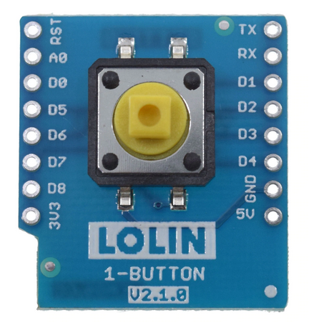
… a big number of sensor shields

Slide 36
which micro-controller?
Question of
Needs (how much memory, which speed, which interfaces …)
Network interface?
Budget
Software environment and programming language
Previous experience
Taste
Because of its computing power, its interfaces, its network connectivity and its low price we selected the ESP32

Slide 37
Programming the micro-controller
Depending on the processor used, several programming environments are available. For the ESP32 you have:
esp-idf (ESP integrated development framework) provided by Espressif (not recommended for a beginner programmer)
The Arduino SDK (Software Development Kit) originally developed for the Atmel Atmega chips but today available for many micro-controllers including the ESP32.
MicroPython. A stripped down Python-3 interpreter with additional features needed by micro-controllers available for several chips including the ESP32.
In these lectures we use the Arduino SDK

Slide 38
Interfacing to the “things”
The ESP32 has a big number of interfaces implemented on the chip:
GPIO pins
PWM
Capacitive touch sensor
I2C (Inter Integrated Circuit) interface
SPI (Serial Peripheral Interface) interface
Analogue to digital converter
Digital to analogue converter
Timer

Slide 39
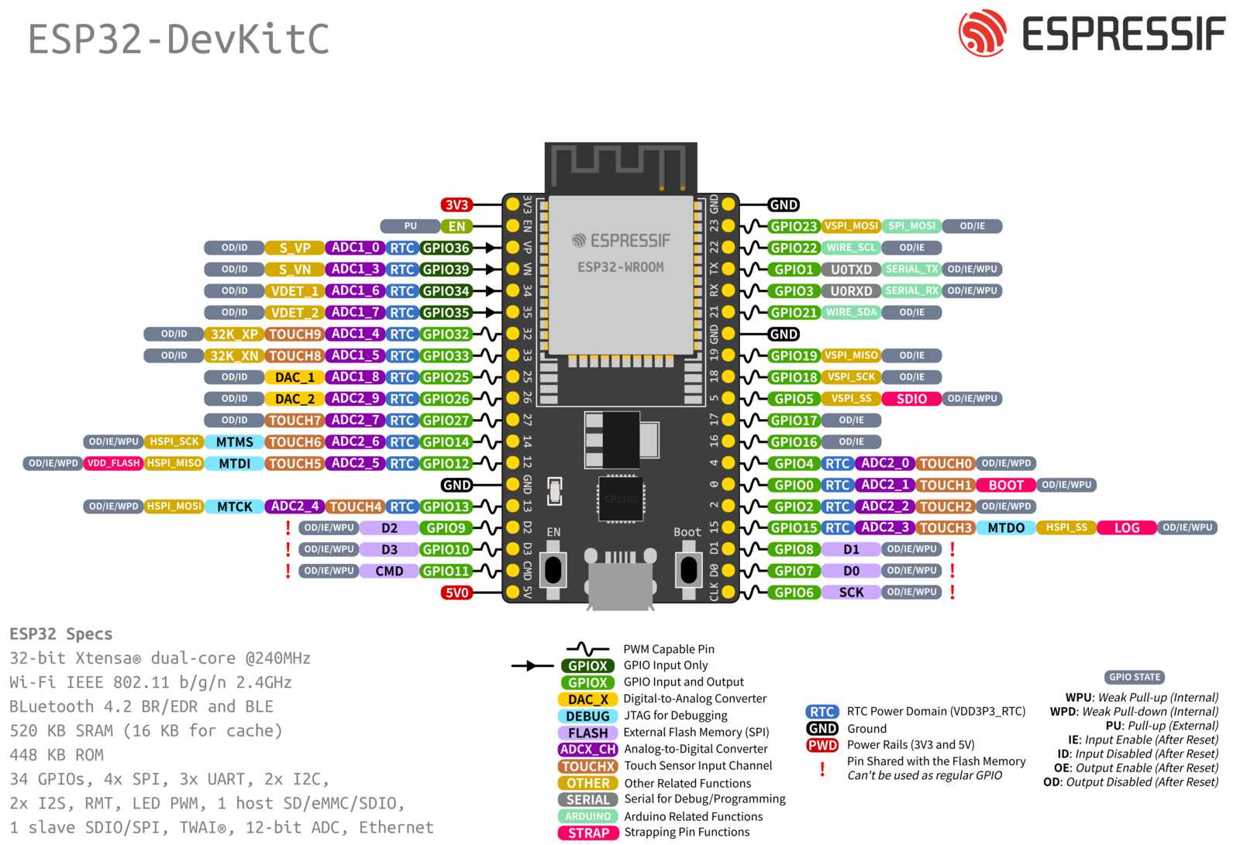
ESP32 pinout

Slide 40
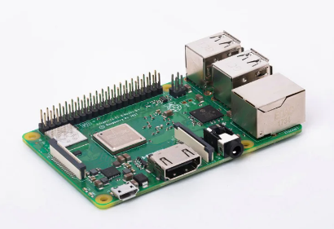
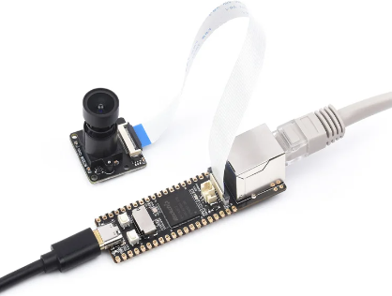
Micro-controllers running Linux
Raspberry Pi 4 or 5
Luckfox Pico Pro Max

Slide 41
The Raspberry Pi
The specifications on a previous slide show that the Raspberry Pi is vastly more powerful than all the other micro-controller we have seen before.
In fact the Raspberry Pi should be considered a complete small computer.
It can use a big SD card as its “hard disk” and run a full blown Linux operating system.
It has an HDMI interface onto which you can connect a monitor screen and it has 4 USB interfaces that can be used with a keyboard and a mouse.
This allows to run Linux autonomously and to have a desktop on the connected screen. All Linux programs can be executed and the C, C++ … compilers can be run natively.
The full C-Python interpreter is available and of course all the Linux network capabilities are there.
However, the Raspberry Pi is also a factor 20 more expensive than an ESP32 not counting the price for screen, keyboard and mouse.

Slide 42
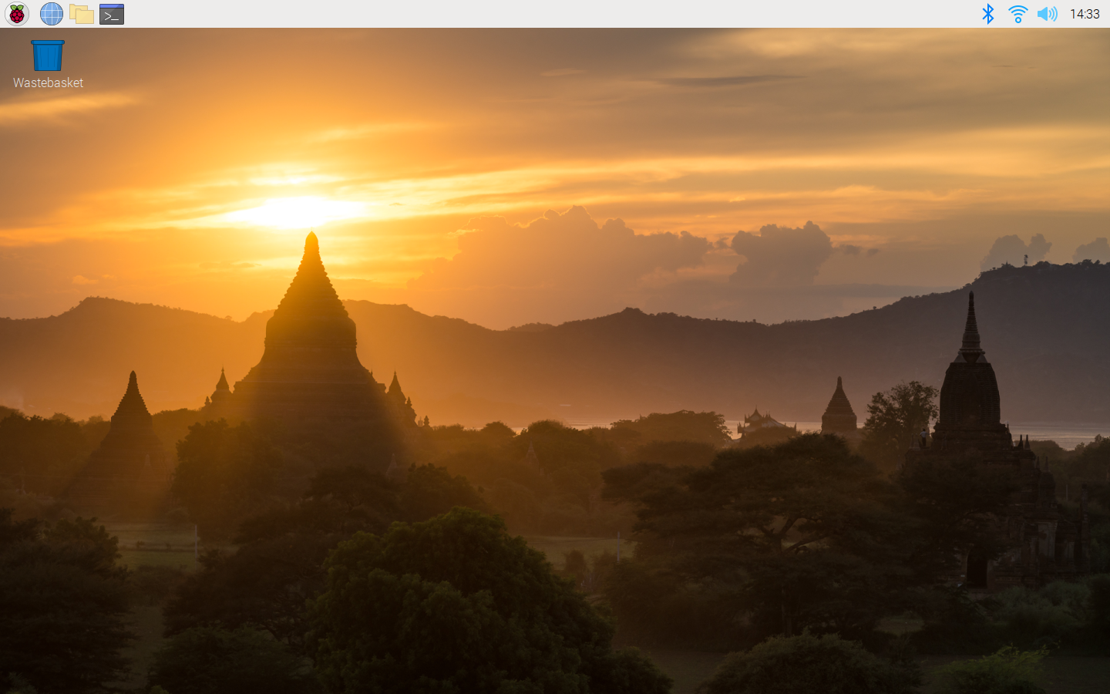
The Raspberry OS screen

Slide 43
Raspberry Pi interfaces
The Raspberry Pi allows to connect external devices through
GPIO
UART
SPI, I2C or CAN bus
just like the ESP32 or the AVR Arduino boards. It does not have a built-in ADC though.

Slide 44
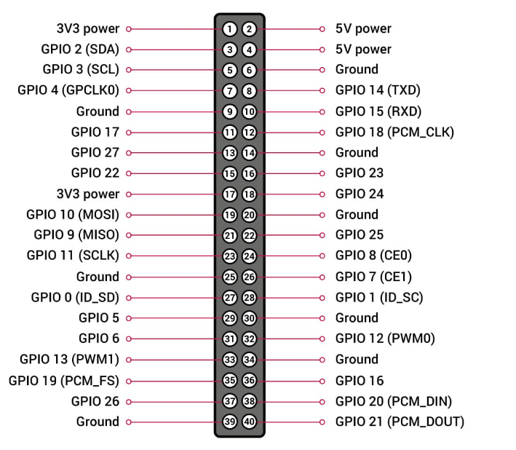
Raspberry Pi pinout

Slide 45
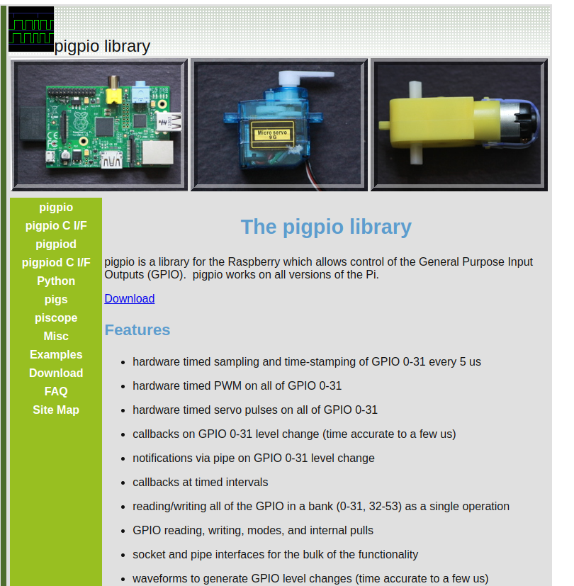
A library to access external devices

Slide 46
The Luckfox Pico
Just like the Raspberry Pi, the Luckfox Pico can run Linux off an SD card and it has an Ethernet interface.
However, a screen and keyboard and mouse cannot be connected to it.
You can however connect to the Luckfox over the network using ssh and use the X11-forwarding to get the graphical user interface of your applications on the screen of your PC or MAC.
The Luckfox also has a camera interface and it features a processor for AI applications. It is therefore particularly suited for image treatment.
At a price of ~ 20 US$ it is still rather cheap.

Slide 47
Micropython
The Arduino AVR processors are not powerful enough to run a Python interpreter.
The Raspberry Pi runs a full Linux operating system and has access to all its applications including CPython, the standard Python interpreter and its libraries
The ESP32 is somewhere in between. It can run a stripped down Python interpreter called MicroPython, which has extensions needed to access external devices connected through one of the hardware interfaces, GPIO, I2C, SPI UART.
As explained in a previous slide, in Python the source code is converted to binary code on the fly and no compilation step is needed before execution.

Slide 48
Tools for MicroPython
Before being able to use MicroPython the interpreter must be installed on the ESP32 flash.
Then, all that is really needed, is a serial connection to talk to the interpreter on the ESP32 and a program to upload code.
minicom is such a terminal emulator and ampy allows to upload (source) code and execute it.

Slide 49
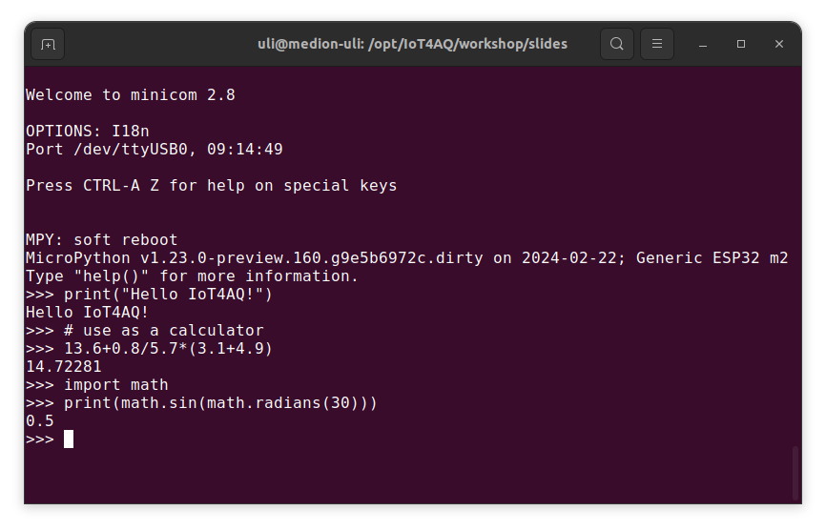
minicom

Slide 50
Thonny, an IDE for MicroPython
Just like the Arduino SDK with its editor, C++ compiler, up-loader and serial monitor, MicroPython has an IDE called “thonny”
It allows to edit programs, upload them to the ESP32, execute them and see the results on a terminal window.
The terminal window also allows to access MicroPython’s REPL (Read, Execute and Print Loop). Like this commands can be given to MicroPython without a program.
In fact it is possible to control external devices without writing a single line of code.
MicroPython implements a simple file system in flash, onto which code, libraries but also images, sound files … can be stored.

Slide 51

Thonny

Slide 52

A WEB server controlling the user LED

Slide 53
References
The C++ Programming Language, Bjarne Soustrup
Arduino Cookbook. O’Reilly
Developing IoT Projects with ESP32, Bedat Ozan Oner
The MicroPython documentation
https://afnog.iotworkshop.africa/do/view/Main/WebHome (embedded systems with Raspberry Pi (C- language), IoT with ESP32 using MicroPython

